Slide 1

Welcome

Slide 2
Group 8
Digital Logic Design
3-Bit Binary to Gray Code Converter
MD SHAFKAT FARUK KHAN (2022-3-60-035)
Md.Akil Hossain (2023-2-60-091)
Kashpia Rahman (2021-2-60-003)
Nosrat Jahan Fahima (2024-1-50-038)

Slide 3
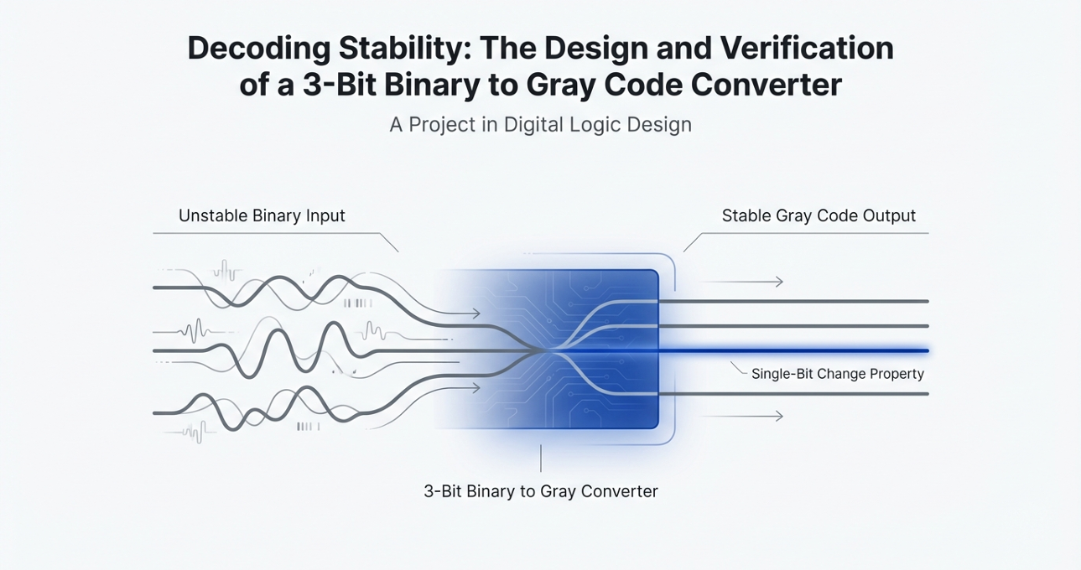

Slide 4
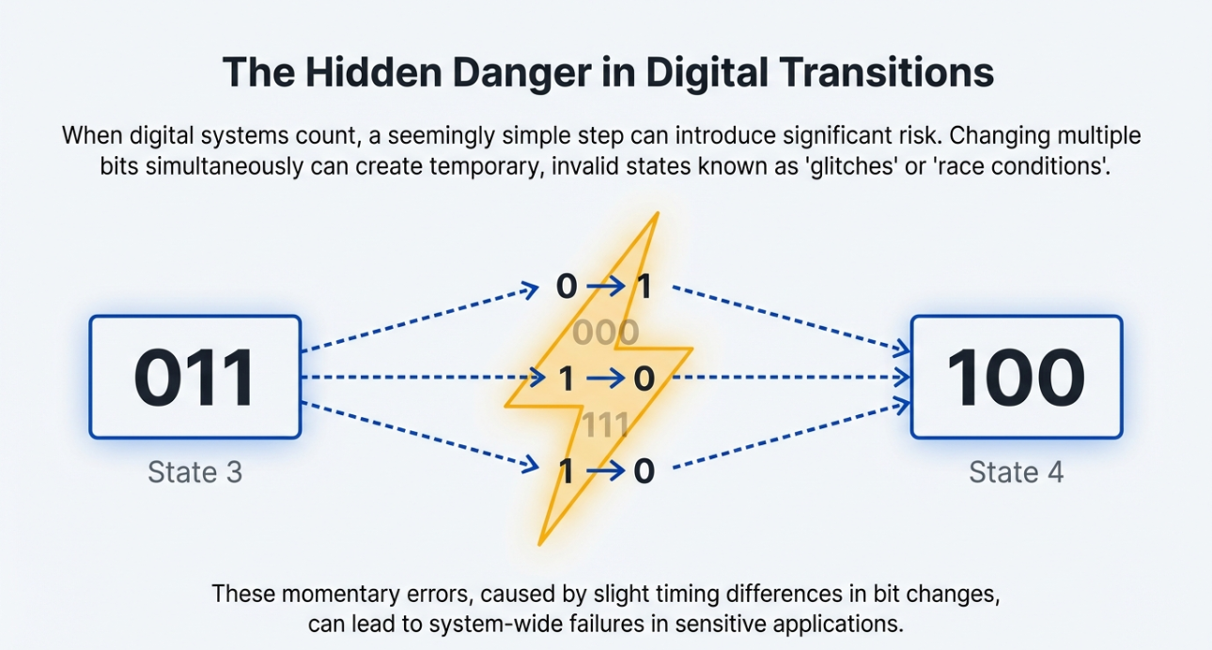

Slide 5
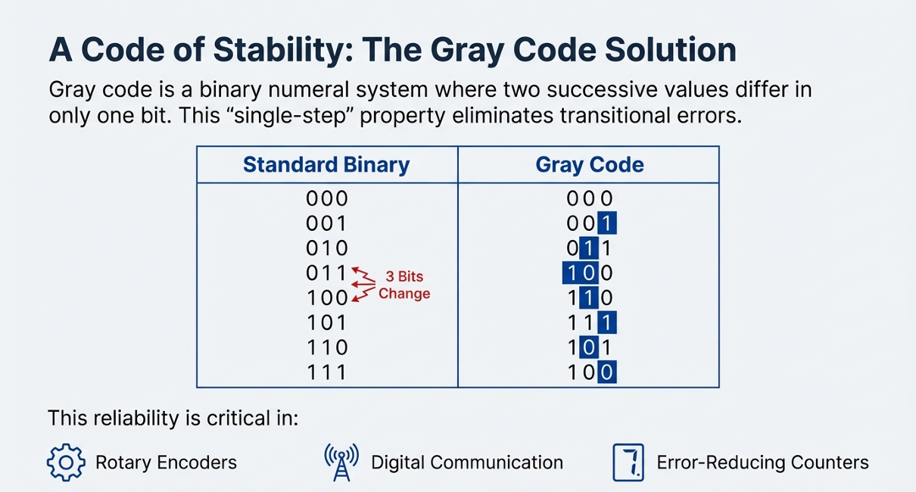

Slide 6
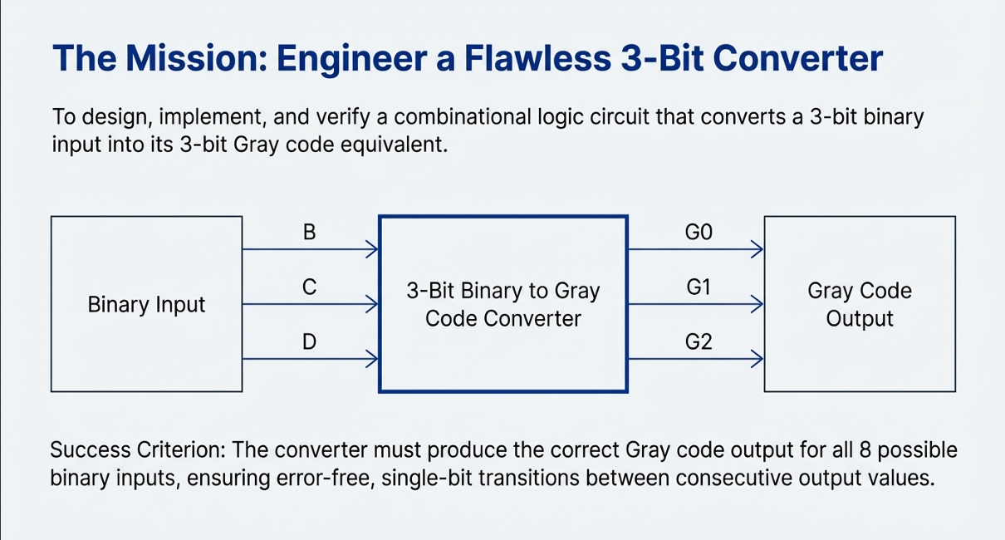

Slide 7
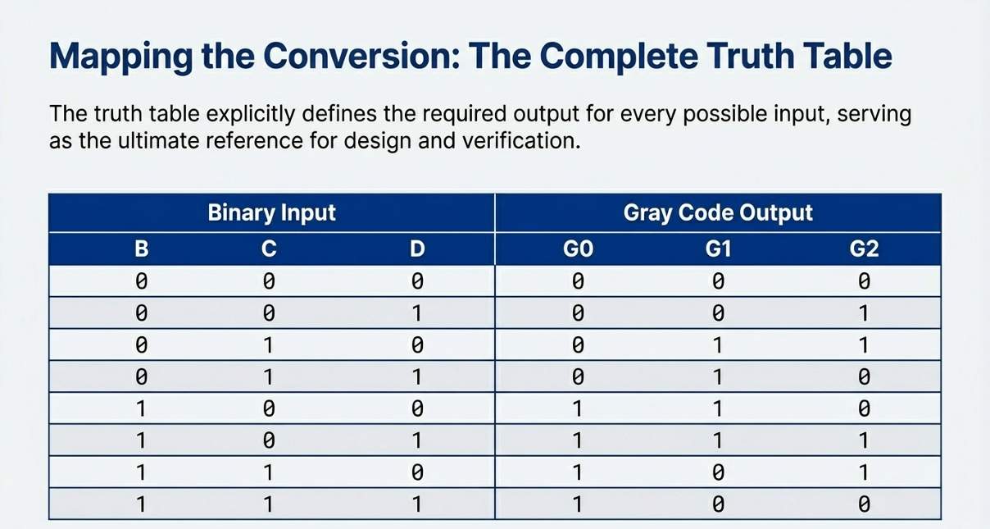

Slide 8
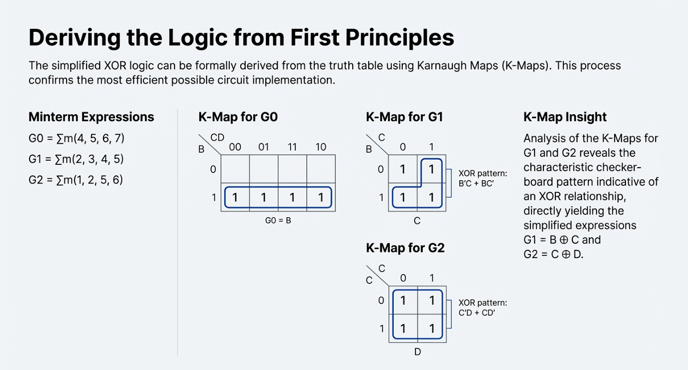

Slide 9
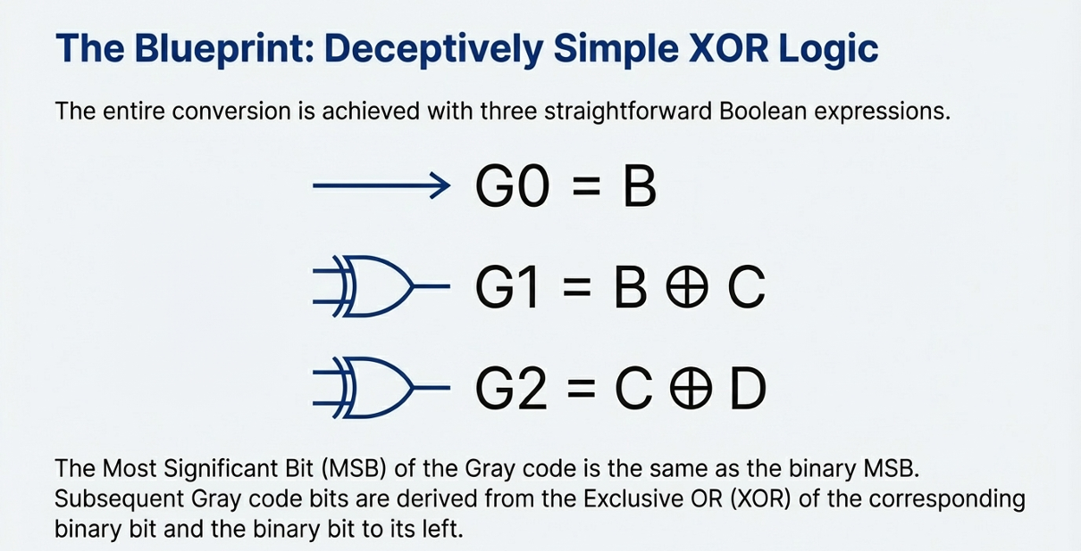

Slide 10
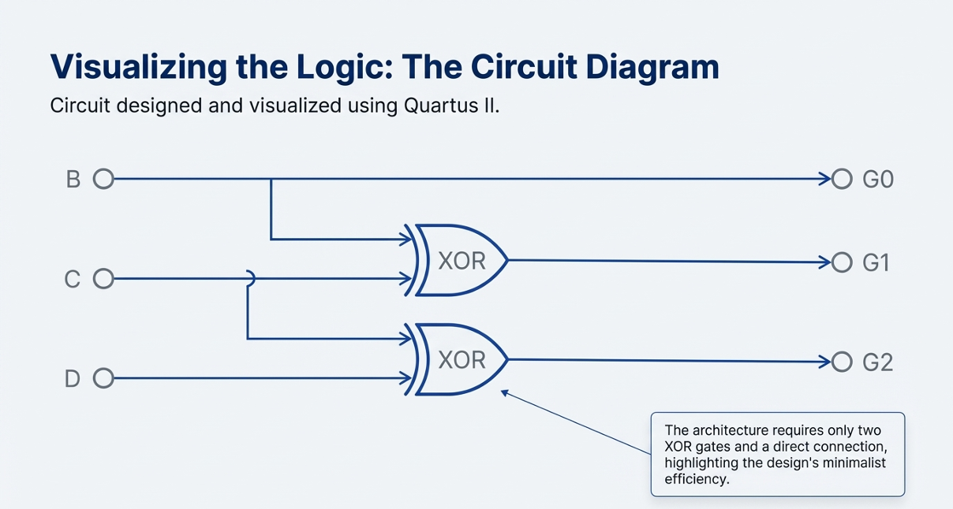

Slide 11
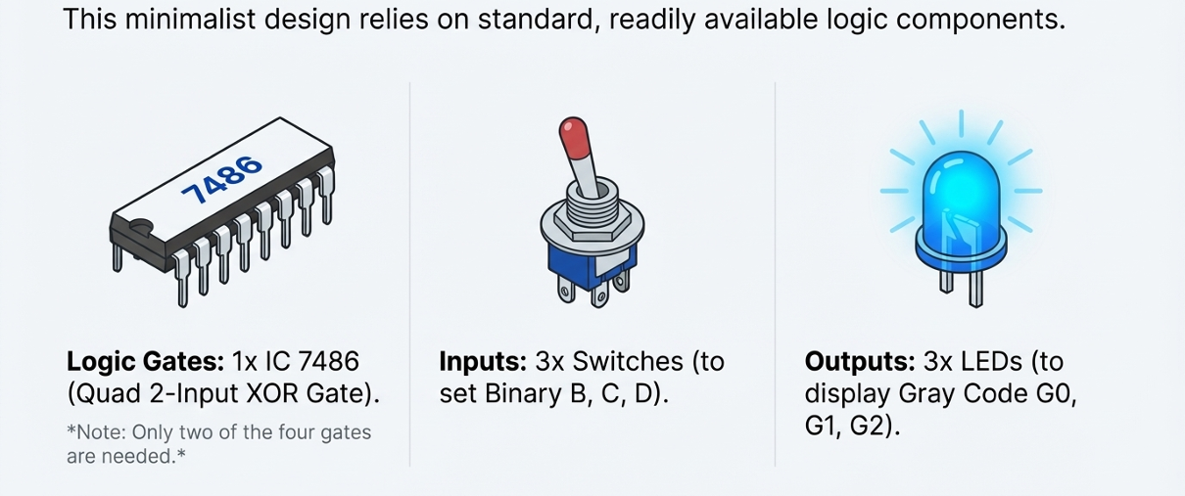
Materials Needed

Slide 12
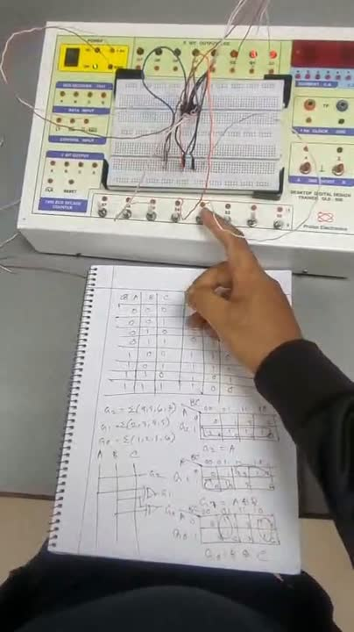
Lab Simulation

Slide 13
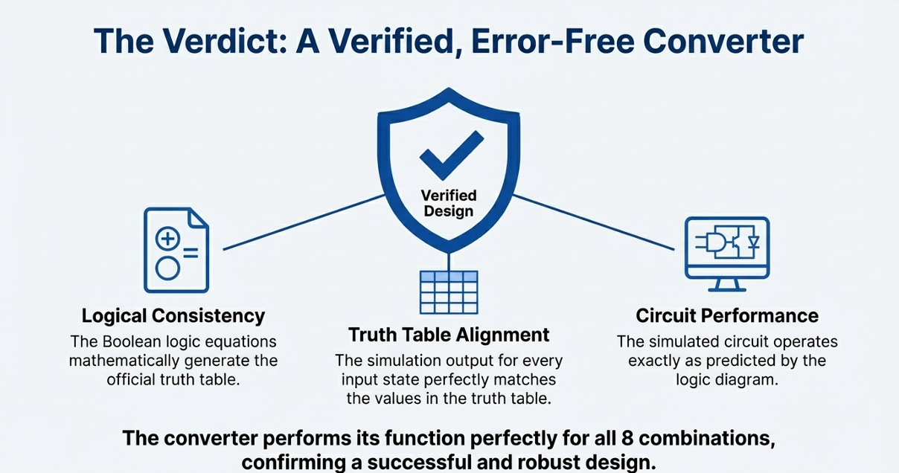

Slide 14
Thank You

